Slide 1
ASP.NET Core
ASP.NET Core is a cross-platform, open-source, and high-performance framework used for building:
✅ Web Applications
✅ RESTful APIs (Web APIs)
✅ Microservices
It’s the modern version of ASP.NET, redesigned from scratch to work on Windows, Linux, and macOS — part of the .NET Core platform.

Slide 2
Key Features of ASP.NET Core
No. | Feature | Description
1 | Cross-Platform | Run your web apps and APIs on Windows, macOS, or Linux.
2 | Open Source | Free and community-driven; hosted on GitHub.
3 | Unified Framework | One framework for Web Apps, APIs, Blazor, SignalR, etc.
4 | High Performance | Among the fastest web frameworks in benchmarks.
5 | Built-in Dependency Injection (DI) | Supports DI natively for clean, testable code.
6 | Middleware Pipeline | Flexible request pipeline that replaces old “HttpModules.”
7 | Cross-Platform Web Server (Kestrel) | Lightweight and fast web server built into .NET Core.
8 | Modular & Lightweight | You include only what you need via NuGet packages.

Slide 3
Key Features of ASP.NET Core
No. | Feature | Description
9 | Supports MVC & Razor Pages | You can use either MVC pattern or page-based model for web UI.
10 | Supports RESTful APIs | Build backend APIs easily using controllers and JSON responses.
11 | Integration with Front-End Frameworks | Works with Angular, React, Vue, etc.
12 | Unified Hosting Model | Can host via Kestrel, IIS, Nginx, or Docker containers.
13 | Security Ready | Middleware for authentication, authorization, and HTTPS by default.
14 | Configuration & Logging | Built-in flexible configuration (JSON, environment vars, secrets) and logging system.
15 | Modern Development Features | Supports Hot Reload, Async programming, and minimal APIs.

Slide 4
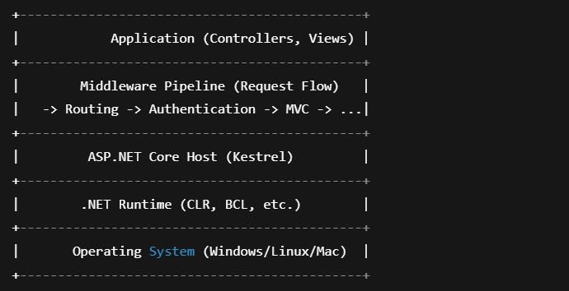
ASP.NET Core Architecture Overview

Slide 5
Common ASP.NET Core Tools
Tool | Description
dotnet CLI | Create/build/run apps (dotnet new, dotnet run)
Visual Studio / VS Code | IDEs for development
NuGet | Package manager for dependencies
Swagger (Swashbuckle) | For API documentation and testing
EF Core | For database integration

Slide 6
ASP.NET Core
ASP.NET Core Project Templates
Given below is the list of project templates that ASP.NET Web Core 2 provides.
ASP.NET Core Web App (Razor Pages).
ASP.NET Core Web App (Model-View-Controller).
ASP.NET Core Web API (no UI).
ASP.NET Core with Angular (SPA).
ASP.NET Core with React.js (SPA).
ASP.NET Core with React.js and Redux (SPA).

Slide 7
ASP.NET Core Project Structure
A typical Web API or Web App project contains:
File / Folder | Purpose
Program.cs | Entry point — configures app, middleware, and services.
Startup.cs (before .NET 6) | Used for configuration and DI setup (merged into Program.cs in .NET 6+).
Controllers/ | Contains API or MVC controllers.
Models/ | Holds entity or DTO classes.
Views/ | (In MVC apps) HTML + Razor view pages.
appsettings.json | Configuration file (connection strings, app settings).
wwwroot/ | Static files (JS, CSS, images).

Slide 8
Request Processing Flow

